Slide 1
Arduino and Robots in the Classroom
Resources for Mentors and Teachers (updated for 2019)
Copyright 2020 Dan McCreary - Moving Rainbow Labs
Creative Commons Sharealike with Attribution for Noncommercial
Notes:
https://creativecommons.org/licenses/by-sa/2.5/

Slide 2

License Agreement
Creative Commons Licensed - Attribution NonCommercial ShareAlike 4.0
As a noncommercial organization, you are free to use and remix this content
Attribution is always appreciated
Use is limited for non-commercial purposes
Link to License Agreement

Slide 3
Overview
What is Arduino?
Why is it so popular?
How to engage students
When to use Arduino in learning (and not use Arduino)
Basic circuits, breadboarding and components
Arduino displays and sensors
Challenges - downloading and drivers
Working with Arduino volunteers
Arduino kits - pre, basic, alternatives, advanced

Slide 4
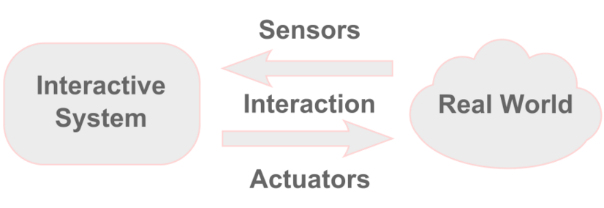
What is Arduino?
The de facto-standard for teaching physical computing
Physical Computing is a creative framework for understanding human beings' relationship to the digital world.
https://en.wikipedia.org/wiki/Physical_computing

Slide 5
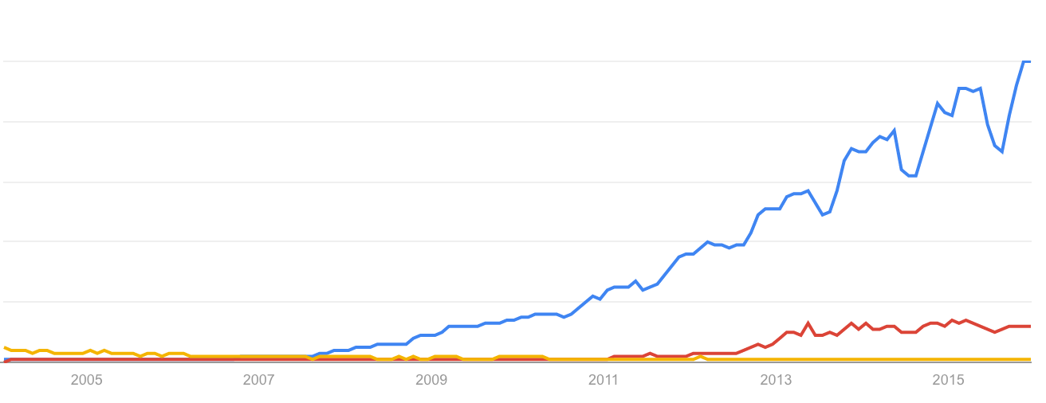
Arduino vs. 3D Printing vs. PIC microcontroller
Arduino
3D Printing
PIC Microcontroller

Slide 6

Four Drivers
Maker Movement
Project-Based Learning
Low-Cost Components*
Social Media
"How to" sites
* If you know where to look

Slide 7
What's New in 2019?
New version of the Arduino IDE
1.8.8 - more features and support for additional processors
New version of Arduino run-time libraries
Requires an additional step to use old run-time libraries
If you have a Nano with the old bootloader you must select
Tools > Processor > ATmega328P (Old Bootloader) to upload.
Lower Cost LED Strips and fantastic OLED DIsplays
$4.30 per meter (60 LEDS per meter)
Many new hardware devices
Low cost ESP-32 replacing the older Uno and Nano
Almost all of the more powerful and more expensive than the Arduino Nano

Slide 8
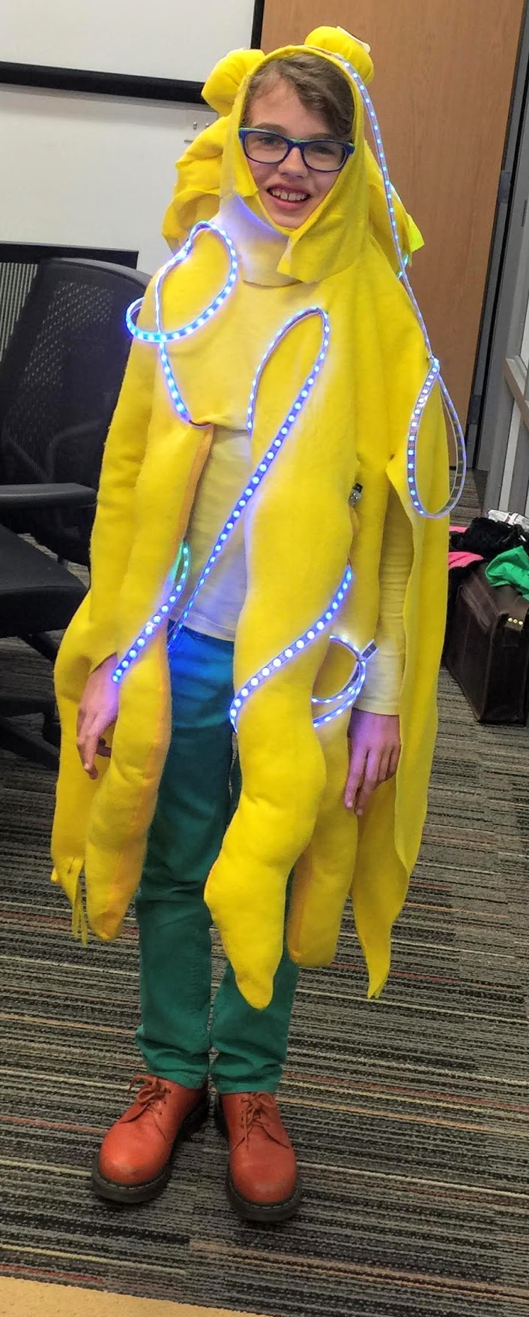
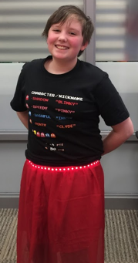
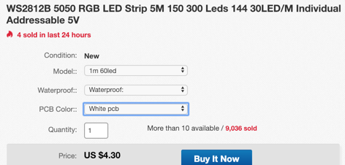
Blue Ringed Octopus
Fantastic Costumes with longer strands of LEDs!
$4.30 per meter!

Slide 9
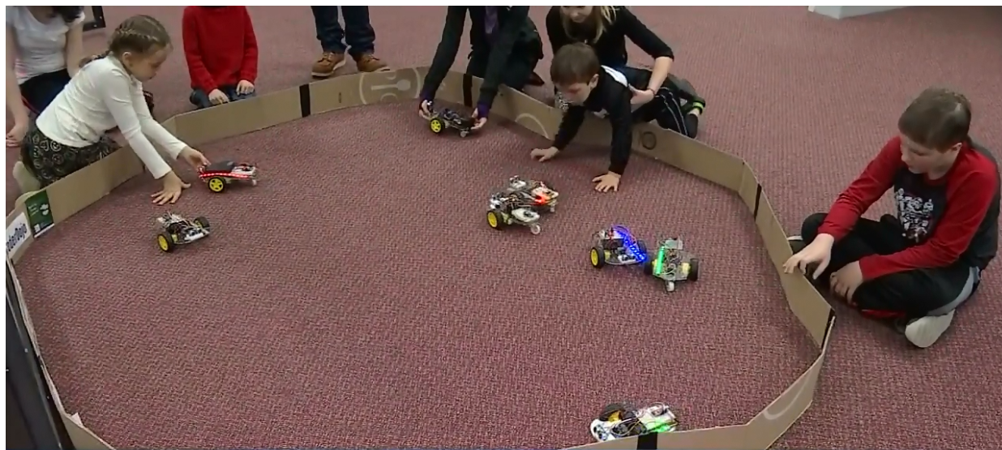
Robot Day at The Works
"Hands-on" for kids 5 to 12 years
Notes:
https://www.youtube.com/watch?list=PLmXh30-EMTVtWAIGz_7pImSKRsJ_z8Yn1&v=pZHZEA6dJro

Slide 10
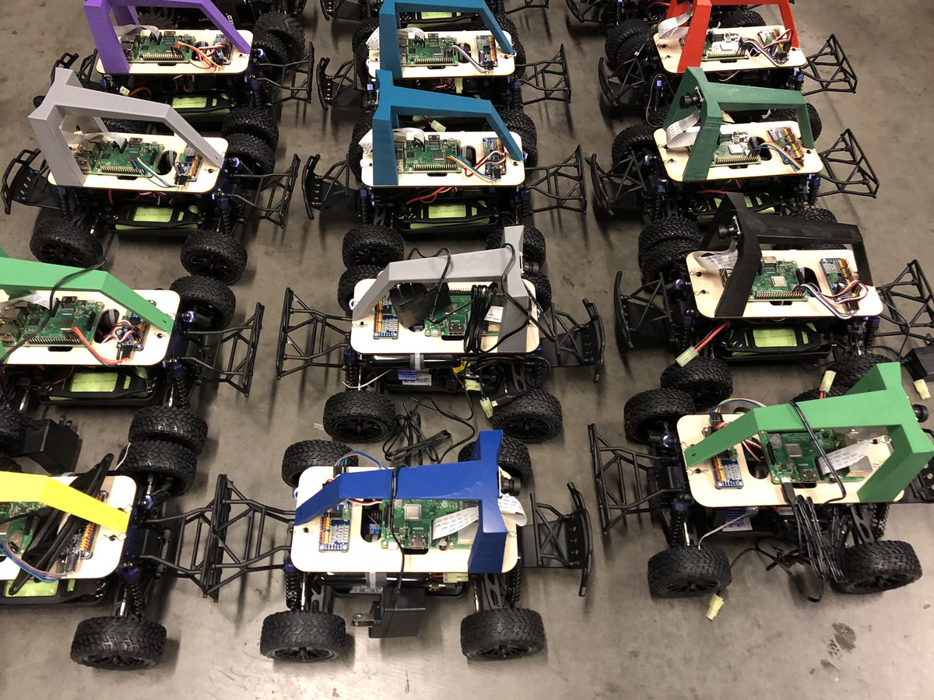
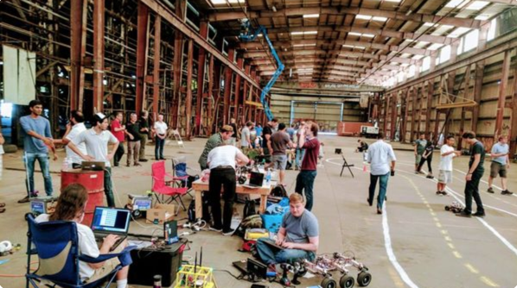
Donkey Car Movement
2,500 members in Oakland CA
Hundreds of people at a events racing their "AI" cars

Slide 11
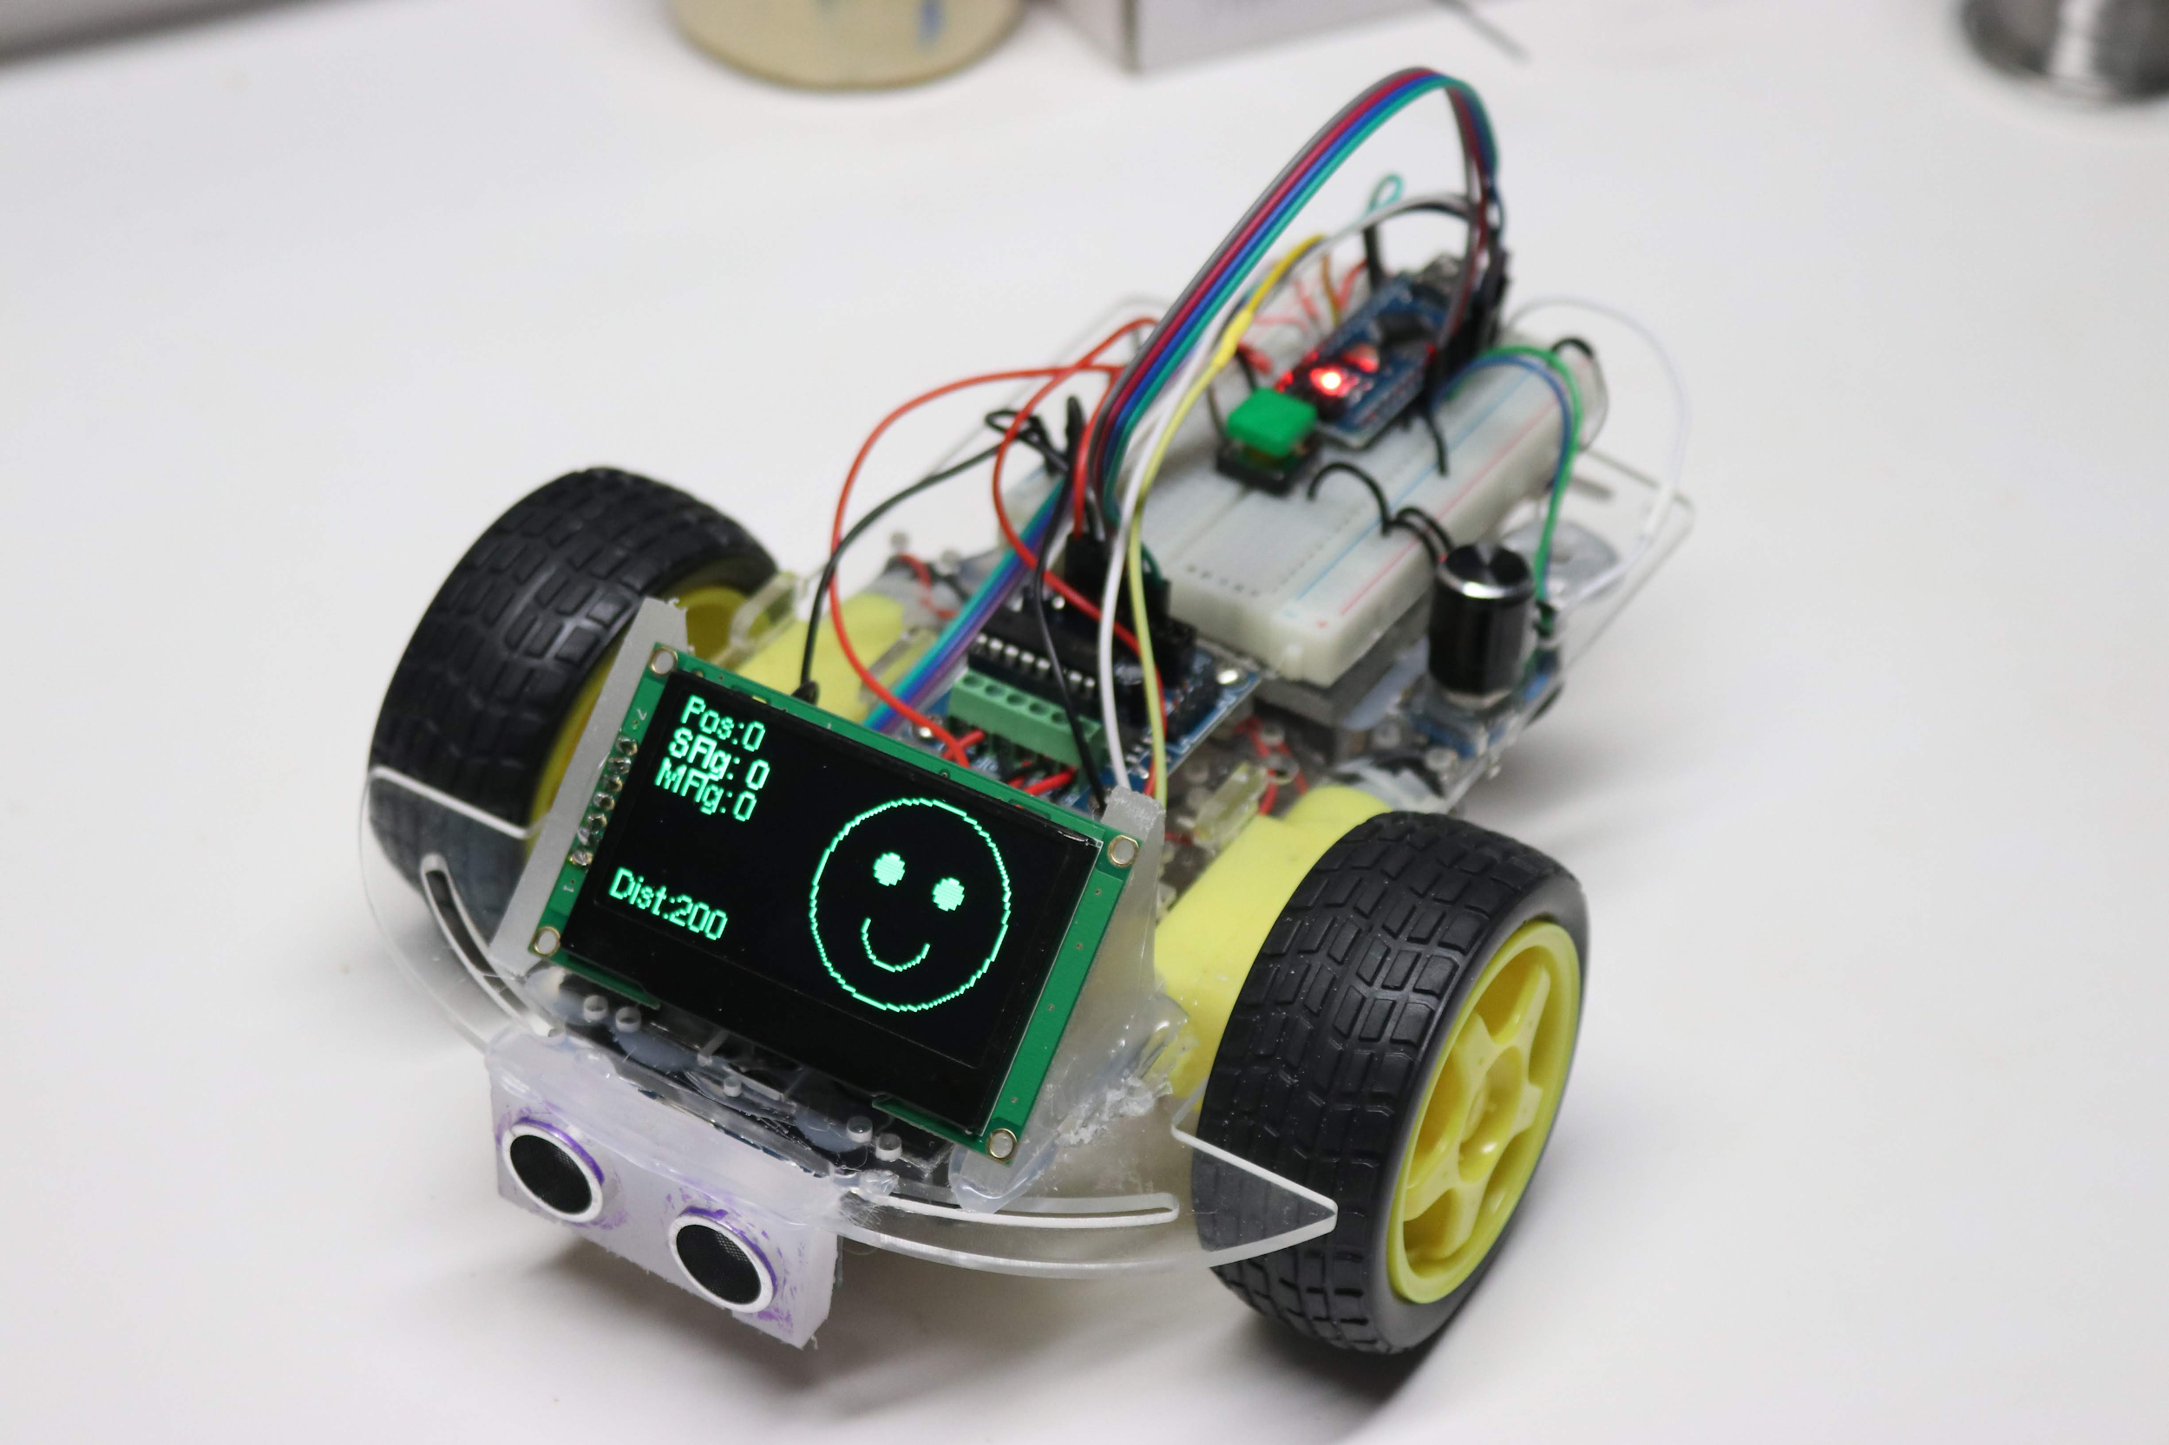
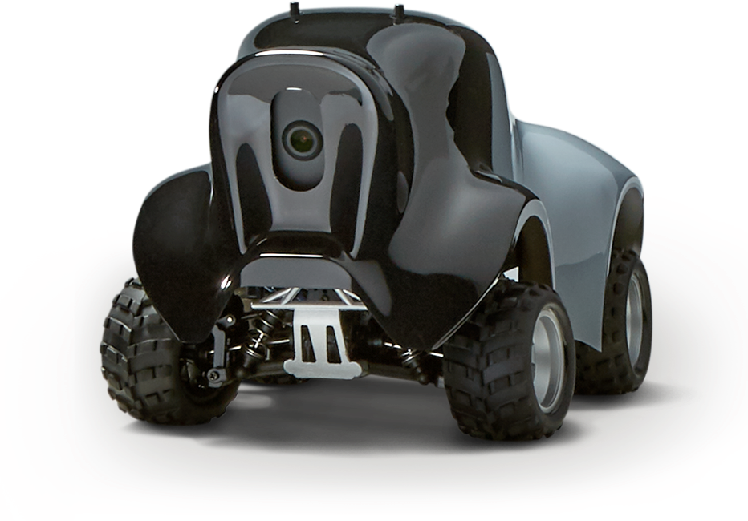
FaceBot and Amazon Deep Racer
$37
$399
$249

Slide 12
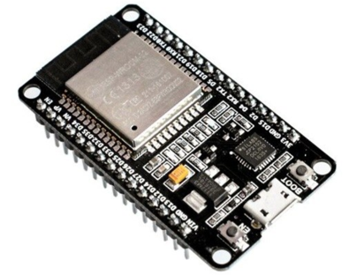
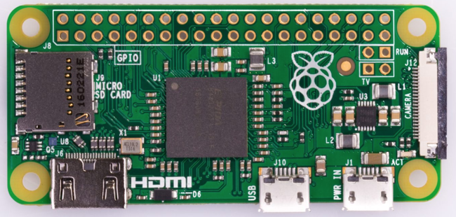
ESP-32 and Pi Zero
512K RAM (Compare with Arduino Uno at 2K)
Built in WiFi and Bluetooth
Use Arduino IDE to program
$6
512K RAM
Built in WiFi and Bluetooth
Linux OS
$20

Slide 13
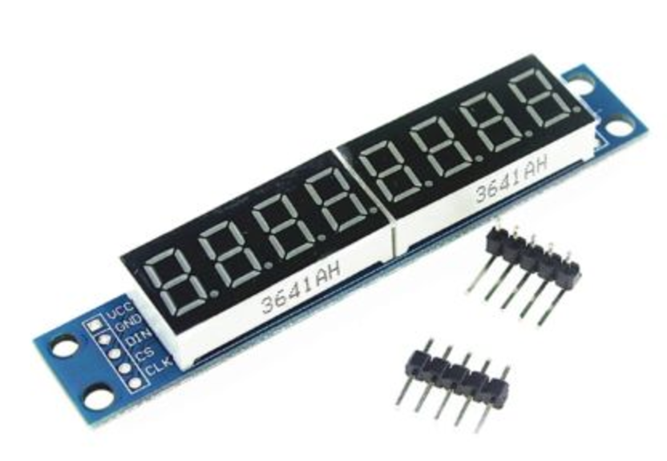
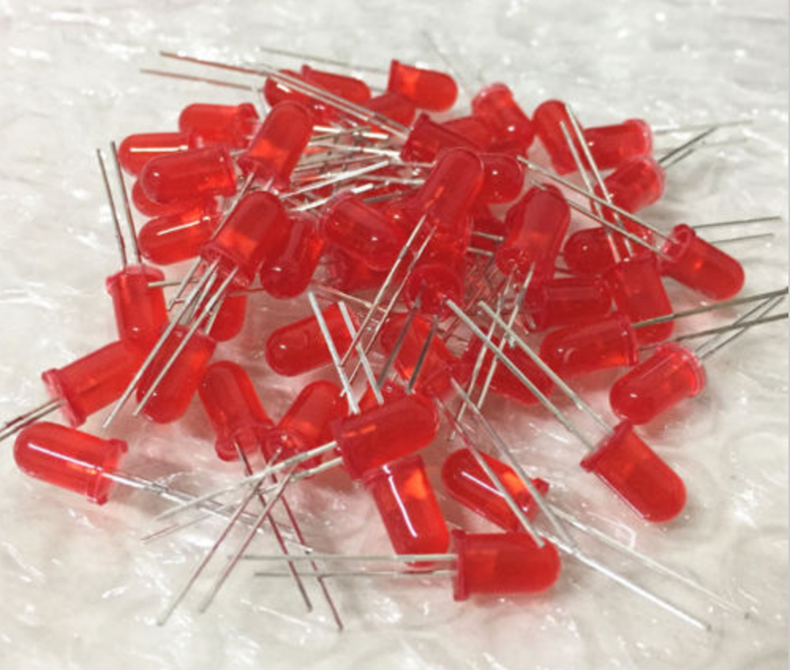
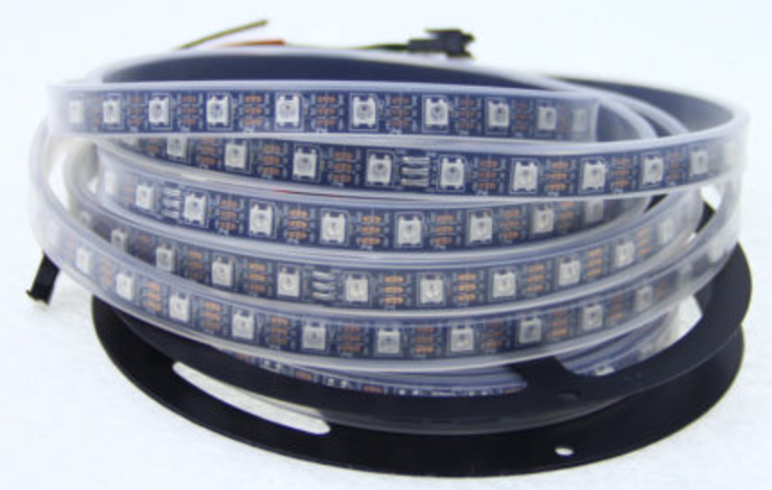
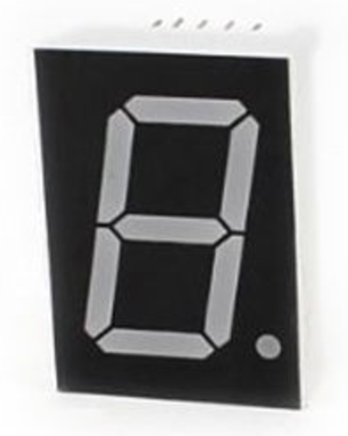
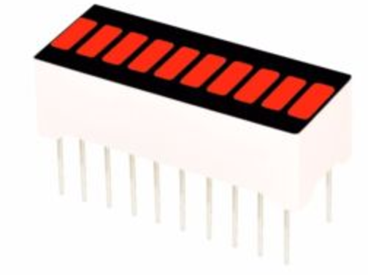
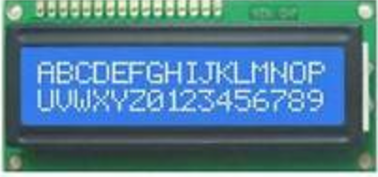
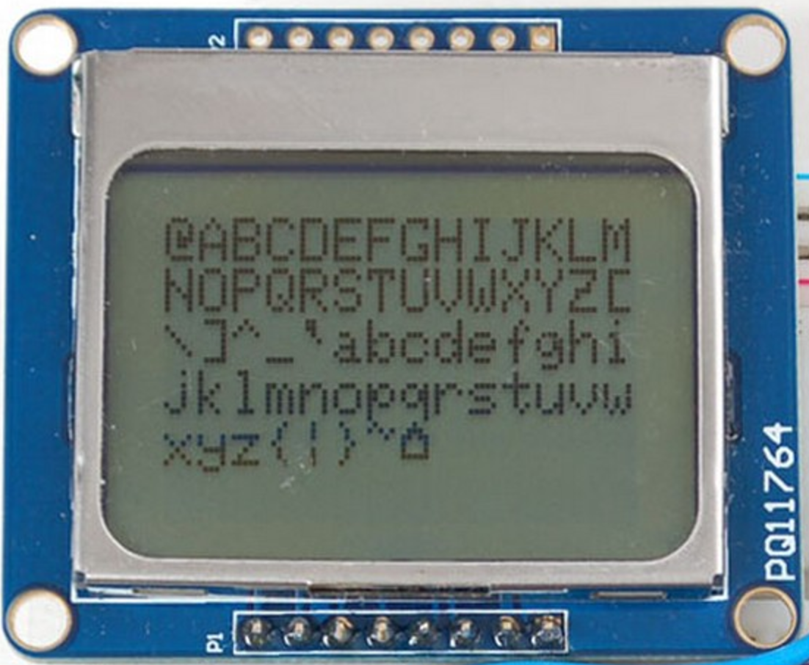
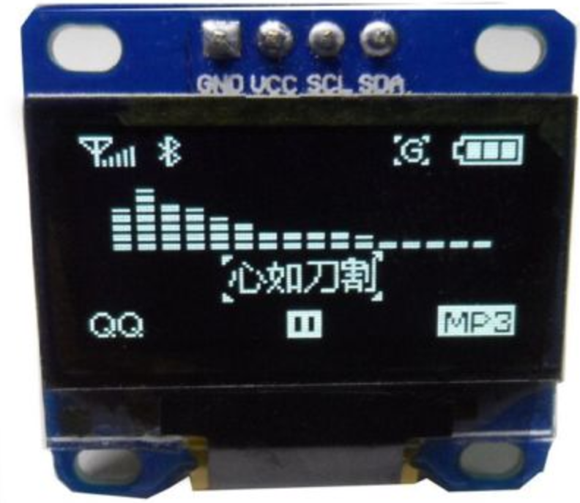
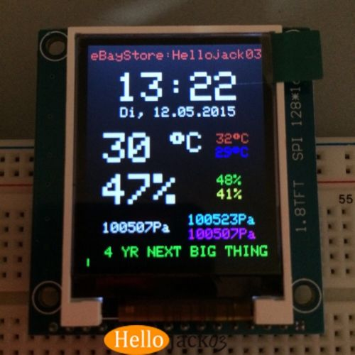
More Displays - easier to use!
LED (1 cent)
10 segment bars ($1.20)
Addressable RGB LED Strip 60 per meter ($10/meter)
7 Segment display (20 cents)
8-digit 7 segment displays ($3)
16x2 Backlit LCD with 2-wire I2C ($1.49)
Nokia 5110 LCD 84x48 ($4)
0.96" OLED 128 x 64 with 2 wire I2C interface ($3.50)
2.8" TFT 128 x 160 ($9)

Slide 14
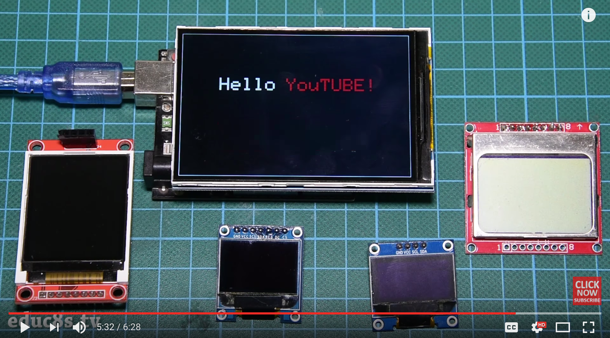
Larger Arduino Displays
https://www.youtube.com/watch?v=E6quVf1_BIg
Lower cost, more colors, higher resolution, easier to connect with fewer wires

Slide 15
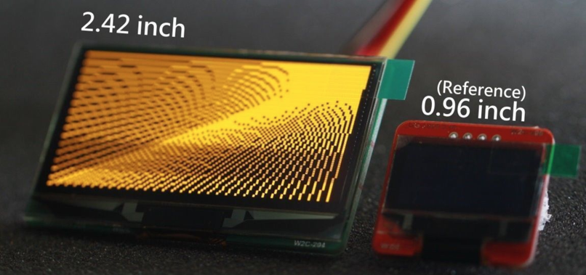
2.42 inch monochorme 128x64 OLEDs for $17

Slide 16
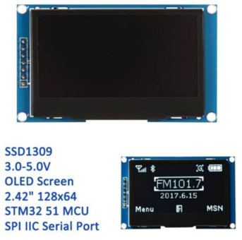
2.24 OLED Screen
Very high contrast
Low power
Easy to program with the u8l2 library
Five pins (plus GND and +5V)

Slide 17
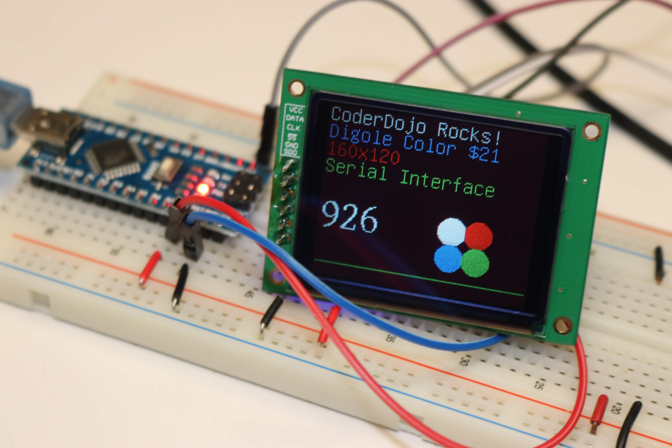
Color OLED 160x120 $21 from Digole
Special serial software to make drawing fast

Slide 18

$37 Facebot
64x128 OLED display
Bright, high contrast, large viewing angles
Adds $12 to the price of the base CoderDojo robot

Slide 19
Strategy
Focus on making the first five labs fun
Focus on engaging students and identifying their interests
Most students that get through the first labs without frustrations go on to do more on their own
Pay careful attention to all the details of the first few labs
Once students have foundational knowledge they can "Google" for ideas and solutions
Partner projects with 2-hours of mentoring every other week

Slide 20
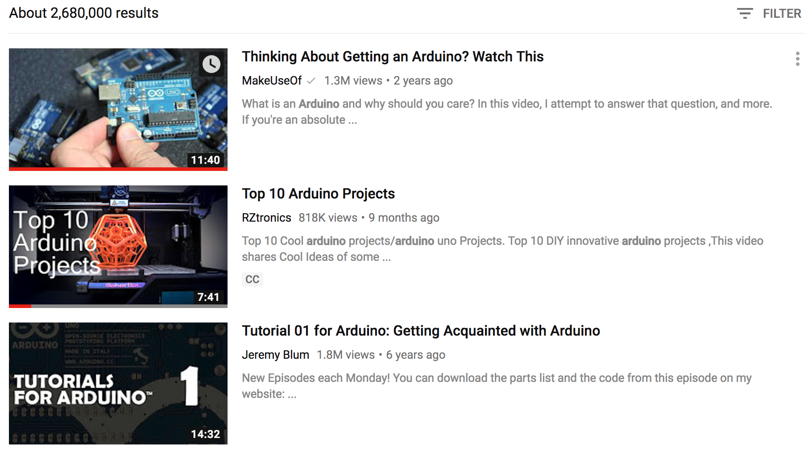
1.82 2.6 Million Arduino Videos on YouTube
Huge repository of learning
Everything from basic usage to advanced topics
Students love to show their projects

Slide 21
Teaching and Arduino in Practice
A software development platform with associated standard chips
An open platform for makers to build things
A framework for teaching physical computing, electronics and computer science
A system for building rapid prototypes in industry
A place where we can find trained volunteers!

Slide 22
Keys to Involvement
Use Color!
Use Motion!
Affordable kits (under $15) that can be taken home
Get students to work in teams
Encouraging their own ideas
Students become the best "sales people" (show and tell)
Leverage a growing community of volunteers
The "right" amount of parental involvement

Slide 23
Fitting to Learning Objectives
Physics
Conductivity, voltage, current, power, batteries
Computer Science
Loops, variables, datatypes, conditionals
Art and Costume Design
Color, patterns, sensors, interactivity, wearability
Robotics
Motors, servos, sensors, control theory,

Slide 24
Knowledge Foundations
Arduino Projects
Sensors
Displays
Arduino Functions
Breadboarding
Arduino IDE
Basic Electronics
Computer Science

Slide 25
Challenges
Complexity
What do we need to know before we add Arduino to our classroom?
What happens if there is a problem I can't fix?
What goals are realistic?
Laptops
Arduino IDE
USB Drivers
Arduino Libraries

Slide 26
Learning Paths
Halloween Costumes
Robots
RC-Copter
Exotic Sensors
strips
arrays
OLED
Controllers
Touch
Flex
Servos
Stepper
Light
Sound
Buttons
Knobs
Temp
LED
LCD
Sensors
Displays
Motors
Speakers
Use Headsets
in Classroom
LED Blink Lab
It all starts with "blink"

Slide 27
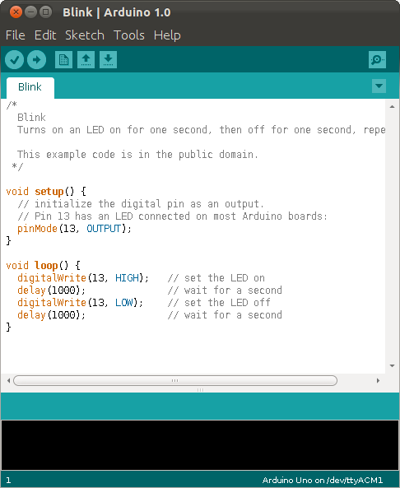
The Arduino Desktop Software
Integrated Development Environment (IDE)
Allows editing, compiling, uploading and monitoring all is one package
Good experience for any future software developer
Learn compile, upload, new, open save and serial monitor
Load examples into your Arduino Home/libraries

Slide 28
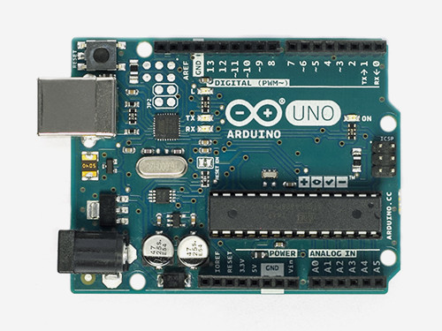
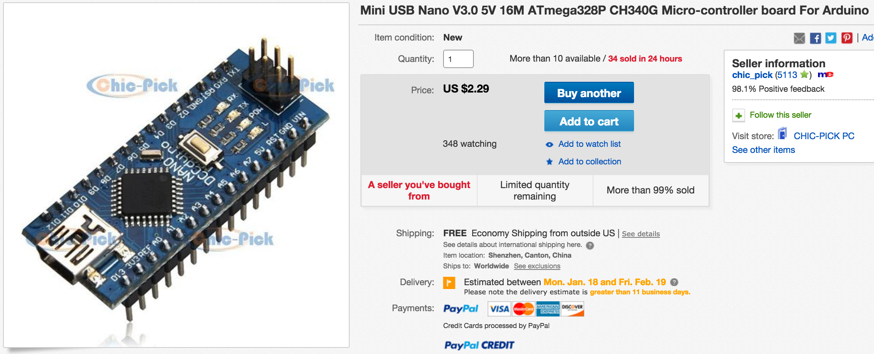
Genuine Arduino vs. Arduino Clones on eBay
http://store-usa.arduino.cc/products/a000066
Option 1: Genuine Arduino From Italy - $29.95 + $3.74 Shipping
Option 2: Arduino Nano Clone from on eBay
$2.29 (free shipping, two weeks delivery from China)
Breadboard friendly but needs a special CH340D driver

Slide 29
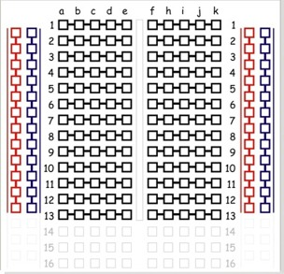
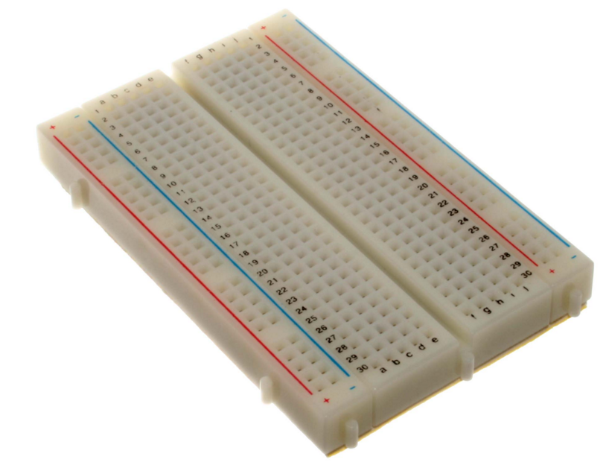
Teaching Breadboarding Skills
400 Tie Medium Breadboard with power rails
Vertical power rails and horizontal row connectors
Available on e-bay for $1.20 each qty 1
Good overview at: https://learn.sparkfun.com/tutorials/how-to-use-a-breadboard

Slide 30
Name the parts
Power Rails
Columns
(Bus Strips)
Red for +5 V
Blue (Black) for GND
Row connectors
Component Slot

Slide 31
Start Slowly - Breadboard Lab
Ask: Have you ever used a solderless breadboard before?
Plug in the Arduino to the USB serial port. Note the power light. Unplug and re-plug the USB to reinforce that the power is coming from the PC
Connect the power (+5) and ground (GND) using jumpers
Plug the motor pins into one of the power rails - note the change in direction when you reverse the connectors

Slide 32
Breadboard LED Lab
Cathode - the negative (-) or ground side is shorter and is connected to the black rail
Anode - the positive (+) side is longer and sometimes has a bend in the wire
Put an LED in the center of the breadboard and note the long side (cathode)
Add a 330 Ohm resistor
Connect the long wire Anode to +5 and the resistor to GND
https://learn.sparkfun.com/tutorials/polarity/diode-and-led-polarity

Slide 33

Cathode and Anode
My short black cat. The short ground (negative) side.
My tall friend Ann who loves red! The long positive side.

Slide 34
LED Circuit
Arduino +5 V
or output pin
Basic Red LED Circuit
The resistor limits the current to around 10 mA
Use this circuit to test the breadboard
Note that you will burn out the LED if you omit the resistor!
Red LEDs have a voltage drop of about 1.8 volts
LEDs cost about 1.2 cents each
Anode
or
3 AA Batteries
Cathode
3.2v
330 Ohm
Resistor
GND

Slide 35
A great time to practice a bit of math...
Voltage
Ohm's Law:
Current =
Restance
I = E / R
Current = Voltage / Resistance
Voltage = 5 Volts - Diode Voltage Drop (1.8 for red) = 3.2 volts
Resistance = 330 Ohms
Current = 3.2 / 330 ~ 0.010 Amps or 10 milliamps
LEDs burn out if the current goes over 20 milliamps
Each full circuit is an equation and the current at any point is the same
Google "LED resistor calculator"

Slide 36
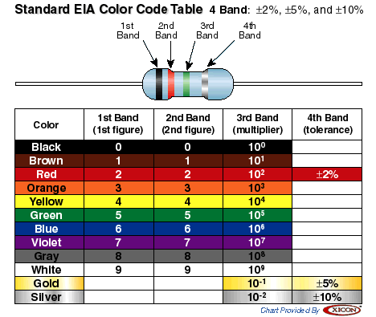
Resistor Codes
330 Ohm

Slide 37
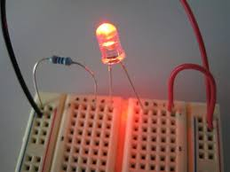
LED Circuit on the breadboard
+5 to power rail
GND to other side
Resistor to one row
LED across the middle
No Arduino required!

Slide 38
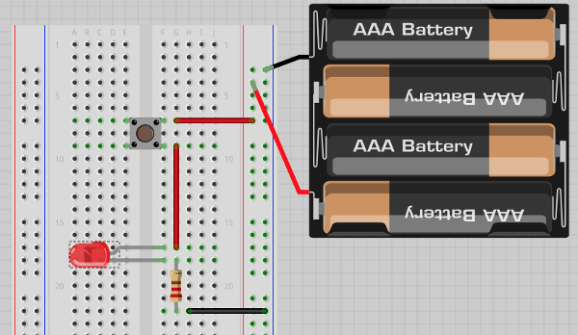
Button Lab
Connect LEDs and resistors in series to momentary push buttons.
Create AND/OR logic circuits
$3/kit
No need for an arduino or laptop

Slide 39
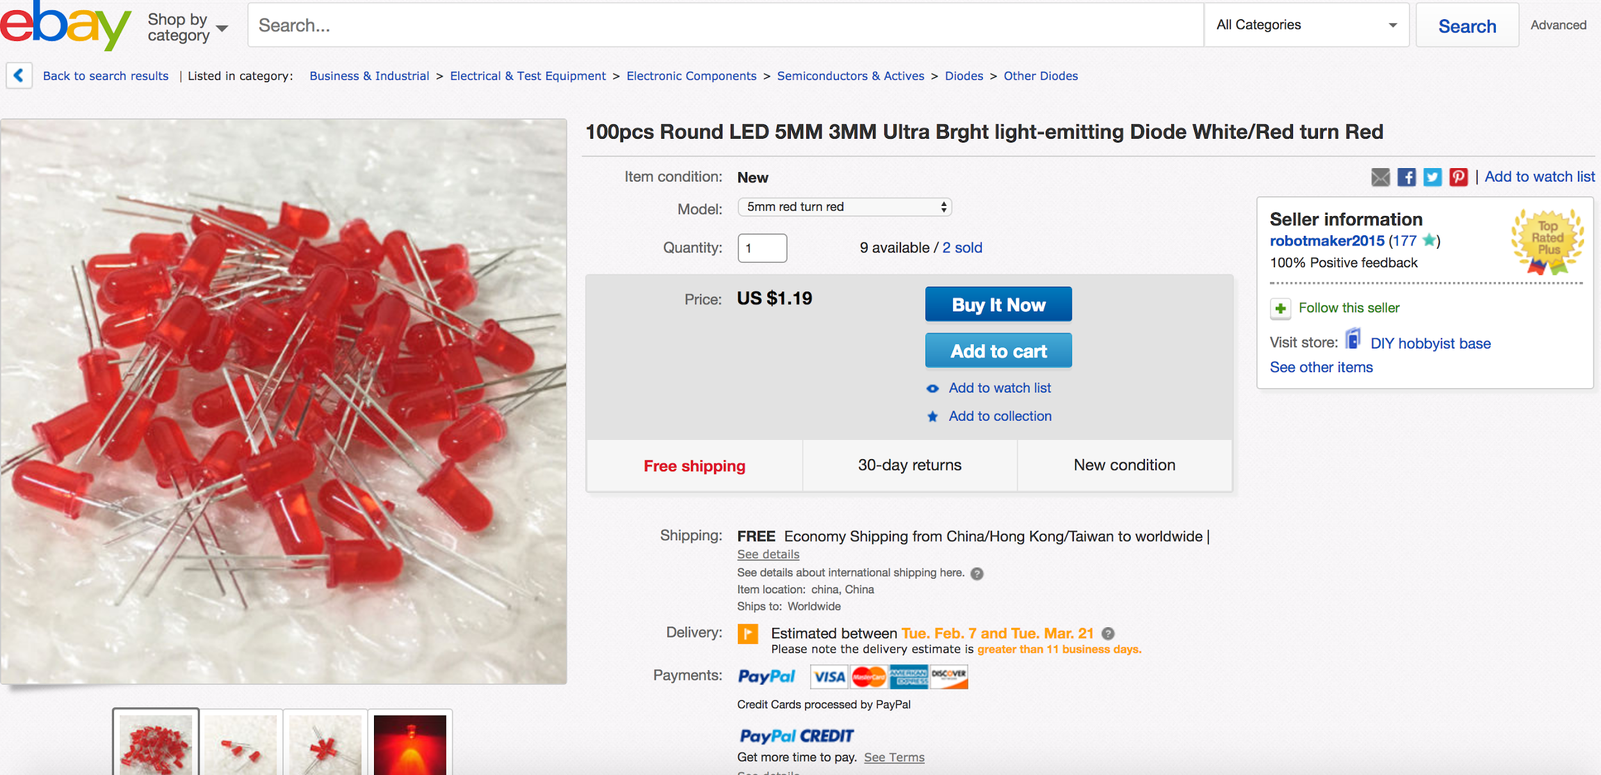
100pcs Ultra Bright Red LED = $1.19 with shipping

Slide 40
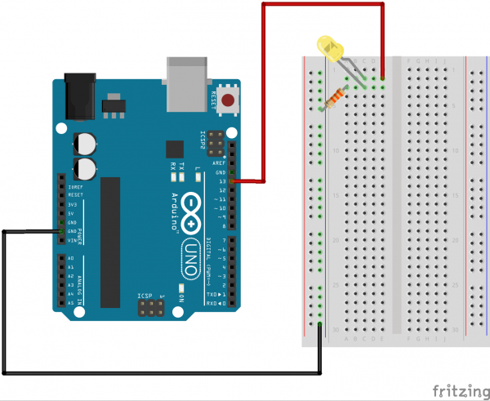
Lab #1: Blink Lab
Replace +5 with power from pin 13

Slide 41
Sample Blink Engagement and Extension Questions
Can you change the speed of how fast it flashes?
What is delay(1000); doing?
What is half of 1000? What does delay(500) do?
Can you make it stay on for twice the time it is off?
Can you make it flash like a heartbeat? (short on, long off)
How fast can you make it flash and still see it flickering?
Do you think that the limits are with the LED or your eye?
Did you know that fluorescent lights do the same thing?
Can you make it flash twice fast and then pause for 2 seconds?
Can you make a second LED flash?
Can you alternate flashing on two LEDs?
Can you make three LEDs flash one after the other?
void loop() {
digitalWrite(13, HIGH);
delay(1000);
digitalWrite(13, LOW);
delay(1000);
}
Incremental complexity
Get them to re-upload a test program at least 10 times….

Slide 42
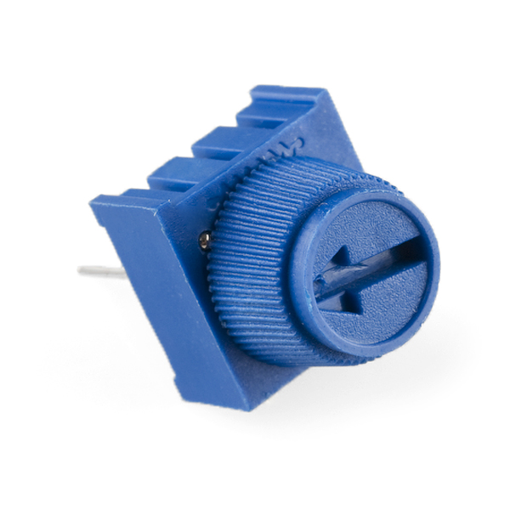
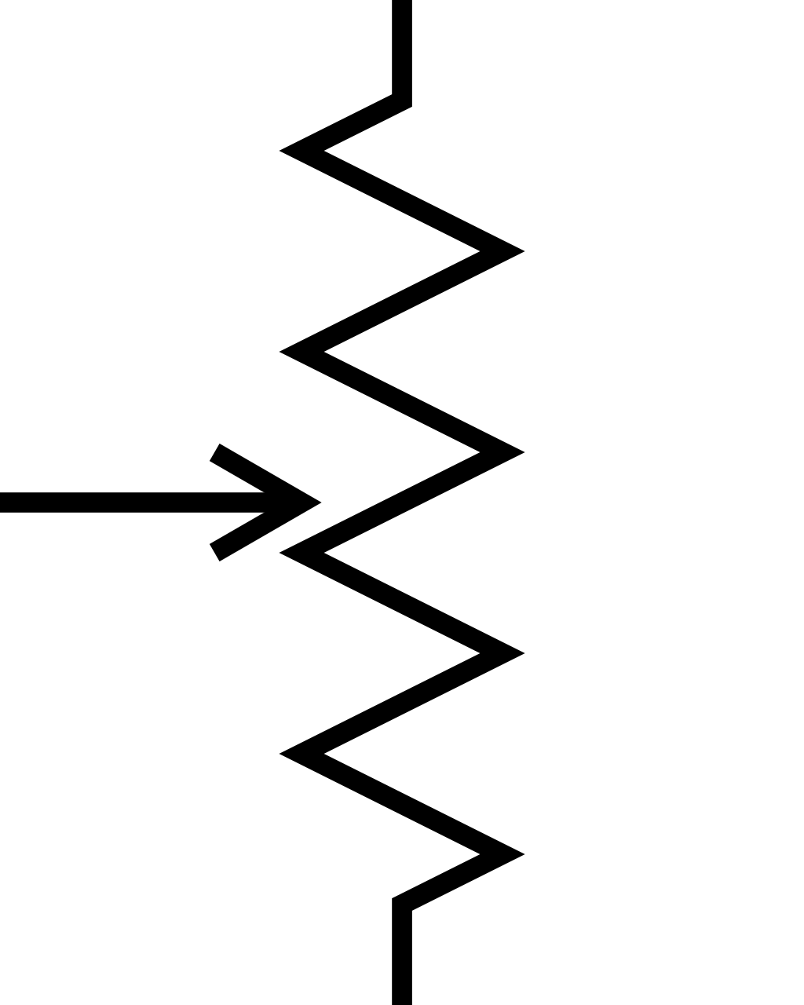
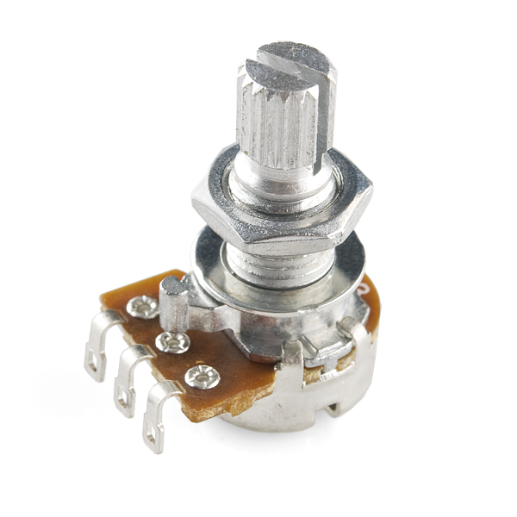
Potentiometer
+5V
Ends of the potentiometer are wired to 5+ and GND
The voltage at the center tap will range from GND to +5v as the knob is turned
The center tap goes to the Arduino port A0
Arduino A0
GND

Slide 43
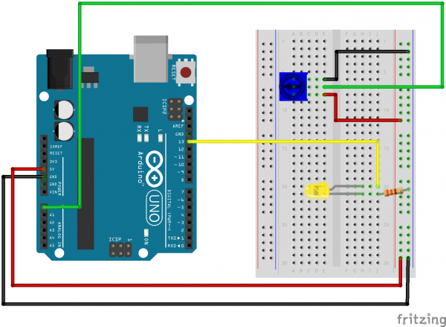
Lab 2: Reading a POT with AnalogRead()
The speed of the LED will change based on the value of the potentiometer

Slide 44
Read Sensor
int sensorPin = A0; // select the input pin for the potentiometer
int ledPin = 13; // select the pin for the LED
int sensorValue = 0; // variable to store the value coming from the sensor
void setup() {
// declare the ledPin as an OUTPUT:
pinMode(ledPin, OUTPUT);
}
void loop() {
// read the value from the sensor:
sensorValue = analogRead(sensorPin);
// turn the ledPin on
digitalWrite(ledPin, HIGH);
// stop the program for <sensorValue> milliseconds:
delay(sensorValue);
// turn the ledPin off:
digitalWrite(ledPin, LOW);
// stop the program for for <sensorValue> milliseconds:
delay(sensorValue);
}
Note use of variables for pin numbers
The value of the sensor (0-1023) will change the delay from 0 to just over one second
Exercise, use the map() function to make the delay vary from 20 to 3 seconds
delay = map(sensorValue, 0, 1024, 20, 3000)

Slide 45
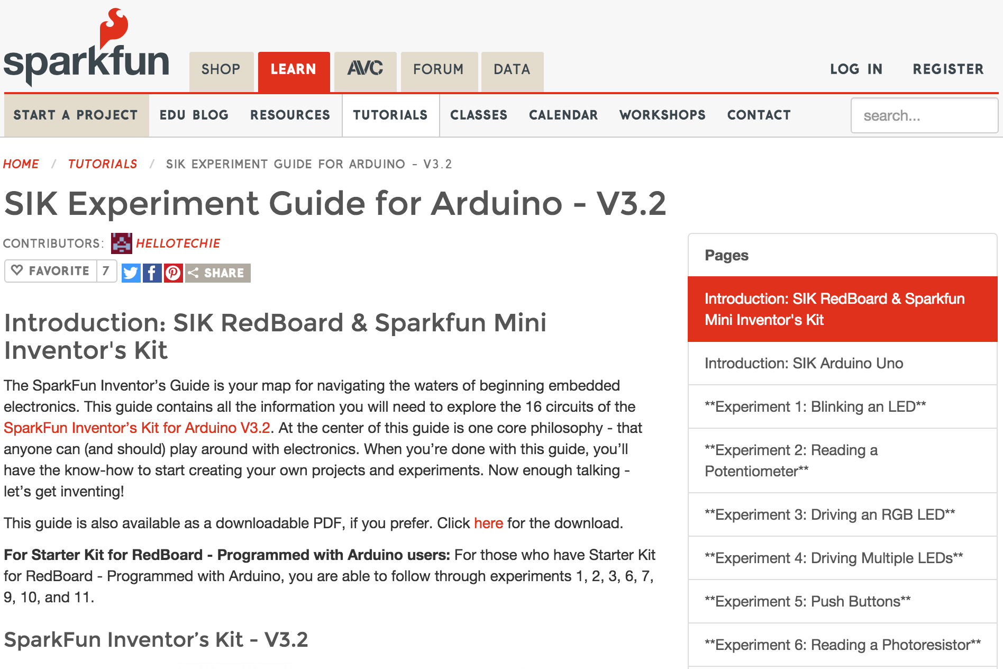
BookMark the "SparkFun Experiment Guide for Arduino"
https://learn.sparkfun.com/tutorials/sik-experiment-guide-for-arduino---v32/

Slide 46
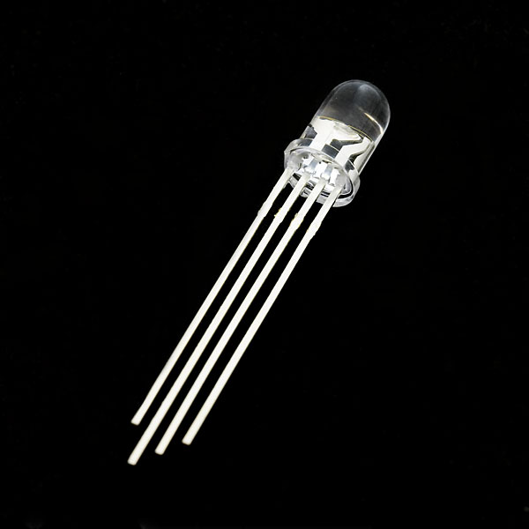
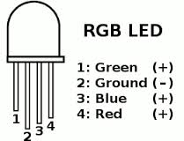
Lab 3: Driving RGB LEDs
Pin 11
Pin 10
Pin 9
GND
RGB Clear Common Cathode LED
Quick - what side is the "Cathode"?
Longest leg goes to ground
Resistors to each other leg

Slide 47
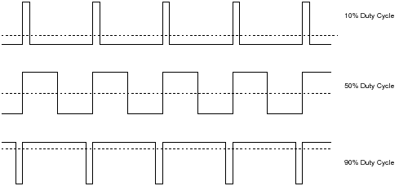
Pulse Width Modulation (PWM)
Using digital HIGH and LOW to simulate an analog value
See analogWrite() https://www.arduino.cc/en/Reference/AnalogWrite

Slide 48
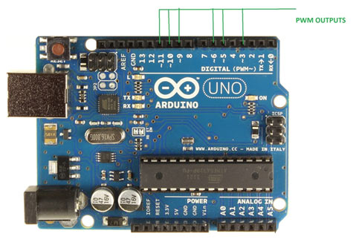
Note the "~" next to pins 11, 10, 9, 6, 5 and 3
Not all output pins support PWM!

Slide 49
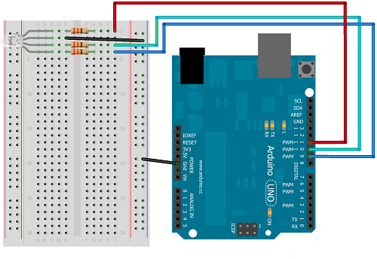
Each pin controls one color (R, G and B)
Wire long pin to GND
Wire other pins through resistors to Arduino PWM pins 9, 10 and 11
Load "Circuit 3" in SparkFun inventor's kit
https://learn.sparkfun.com/tutorials/sik-experiment-guide-for-arduino---v32/experiment-3-driving-an-rgb-led

Slide 50
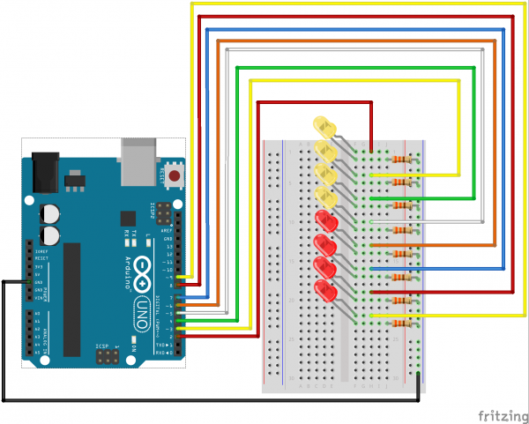
Lab 4: Row of Multiple LEDs
First use of complex data structure (Array of LED pins)
int ledPins[] = {2,3,4,5,6,7,8,9};
First use of "for" loop
Many ways to modify for different patterns!
Well worth the time to wire

Slide 51
Sample for Loop
start
exit condition
increment by one
for(index = 0; index <= 7; index++) { pinMode(ledPins[index],OUTPUT); // ledPins[index] is replaced by the value in the array. // For example, ledPins[0] is 2 }

Slide 52
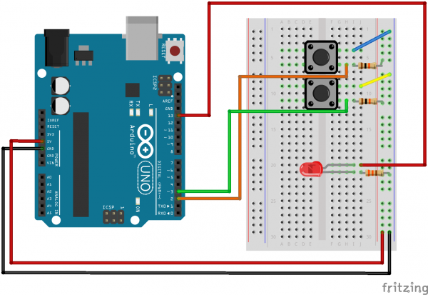
Lab #5: Push Buttons
Use of momentary switch
Analog vs. Digital
Variables
Conditions!

Slide 53
Push Button Code Setup
const int button1Pin = 2; // pushbutton 1 pin const int button2Pin = 3; // pushbutton 2 pin const int ledPin = 13; // LED pin
void setup() { // Set up the pushbutton pins to be an input: pinMode(button1Pin, INPUT); pinMode(button2Pin, INPUT); // Set up the LED pin to be an output: pinMode(ledPin, OUTPUT); }
Note the use of variables for the pin numbers

Slide 54
Conditional IF/THEN/ELSE Logic
if (((button1State == LOW) || (button2State == LOW)) // if we're pushing button 1 OR button 2 && ! // AND we're NOT ((button1State == LOW) && (button2State == LOW))) // pushing BOTH button 1 AND button 2 // then... { digitalWrite(ledPin, HIGH); // turn the LED on } else { digitalWrite(ledPin, LOW); // turn the LED off }
Where is the "Then" Statement? Missing! It is implied after the IF statement

Slide 55
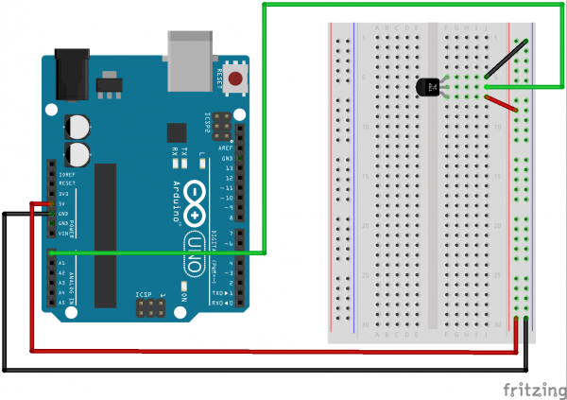
Lab 7: Reading a digital temperature sensor
Analog sensor that sends a voltage that depends on temperature
Use of conversion function
First use of a subroutine function
First use of the printing to the serial monitor
Temperature sensors are very small and easy to lose

Slide 56
Main Loop with Printing
void loop() { float voltage, degreesC, degreesF; voltage = getVoltage(temperaturePin); degreesC = (voltage - 0.5) * 100.0; degreesF = degreesC * (9.0/5.0) + 32.0; Serial.print("voltage: "); Serial.print(voltage); Serial.print(" deg C: "); Serial.print(degreesC); Serial.print(" deg F: "); Serial.println(degreesF); delay(1000);}
float getVoltage(int pin) { return (analogRead(pin) * 0.004882814);}
Same analogRead() as POT lab
Use of float data type
Use of math equations
Use of conversion to units

Slide 57
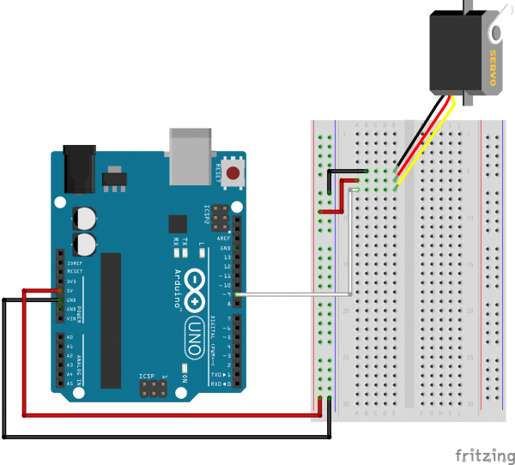
Lab 8: Servos
Change the angle of the arm of a servo
Students LOVE motion!
Change the angle of the servo arm in loop (0, 90, 180 degrees)
First use of a library!
#include <Servo.h> // servo library
servo1.attach(9);
servo1.write(180);

Slide 58

Lab 9: Flex Sensor
Builds on Lab 8
Change the angle of a servo arm based on how much the flex sensor is bending
Favorite lab of many students
Gets them to think about remote robot control

Slide 59

Lab 10: Reading a Soft Pot
Change the color of the RGB LED based on where you touch the sensor
Pins on soft pot are easily bent
Note the 10K pull-down resistor from the middle pin to ground!
Note 10K pull-down resistor (not 330 Ohm)

Slide 60
Other Labs in SIK V 3.2
11 Buzzer (avoid in large classrooms)
12 Relay (hard to use in breadboards)
13 Shift Register (many wires)
14 Motor (small transistors and diodes)
15 LCD display (a favorite but many wires)
16 Simon Game (not included in our kits)

Slide 61

Moving on...
build a computer from components
breadboards can get complex...but the skills they learn now might help in college!

Slide 62

Arduino Nano on a breadboard
Many "kits" start with a low cost Arduino Nano on a breadboard.
Easy to extend.
Short wires to power and ground.

Slide 63
Sensors
analogRead()
Reads the value from the specified analog pin. The Arduino board contains a 6 channel (8 channels on the Mini and Nano, 16 on the Mega), 10-bit analog to digital converter. This means that it will map input voltages between 0 and 5 volts into integer values between 0 and 1023.
Using AnalogRead() function to read values from 0 to 1023
https://www.arduino.cc/en/Reference/AnalogRead
Use map function to convert values into other ranges
newValue = map(inputValue, inLow, inHigh, outLow, outHigh)

Slide 64


All the light we can not see (and sounds we cannot hear)
Encourage students to use sensors that sense "invisible" information
Infrared and Ultrasound

Slide 65


Best Practice Sensors
PIR Motion Sensor (Passive Infrared)
$1.40
http://www.ebay.com/itm/HC-SR501-Adjust-IR-Pyroelectric-Infrared-PIR-Motion-Sensor-Detector-Module-NEW/271638488228
PING Sensor (Ultrasonic distance sensor)
$1.00
http://www.ebay.com/itm/1pcs-Ultrasonic-Module-HC-SR04-Distance-Measuring-Transducer-Sensor-for-Arduino-/171983646391

Slide 66
Not all are real "sensors" but all can be fun
KY-001 Temperature sensor module
KY-002 Vibration switch module
KY-003 Hall magnetic sensor module
KY-004 Key switch module
KY-005 Infrared emission sensor module
KY-006 Small passive buzzer module
KY-008 Laser sensor module
KY-009 3-color full-color LED SMD modules
KY-010 Optical broken module
KY-011 2-color LED module
KY-012 Active buzzer module
KY-013 Temperature sensor module
KY-015 Temperature and humidity sensor module
KY-016 3-color LED module
KY-017 Mercury open optical module
KY-018 Photo resistor module
KY-019 5V relay module
KY-020 Tilt switch module
KY-021 Mini magnetic reed modules
KY-022 Infrared sensor receiver module
KY-023 XY-axis joystick module
KY-024 Linear magnetic Hall sensors
KY-025 Reed module
KY-026 Flame sensor module
KY-027 Magic light cup module
KY-028 Temperature sensor module
KY-029 Yin Yi 2-color LED module 3MM
KY-031 Sensor module
KY-032 Obstacle avoidance sensor module
KY-033 Hunt sensor module
KY-034 Automatic flashing colorful LED module
KY-035 Class Bihor magnetic sensor
KY-036 Metal touch sensor module
KY-037 Sensitive microphone sensor module
KY-038 Microphone sound sensor module
KY-039 Detect the heartbeat module
KY-040 Rotary encoder module

Slide 67
Success Stories
LED Costume Kit ($13.5)
Done with the Internet of Things Hackfest
LED Strip Box (Moving Rainbow)
Motor Controllers
Simple kit to move a motor forward and reverse
CoderDojo Robot
Done as advanced projects for CoderDojo students

Slide 68
Sample Beginner Projects
Nightlight (photosensor and LED)
Room Alarm (PIR sensor and buzzer)
Temperature display and alarm
Tilt sensor and alarm
Simple Simon pattern replay game (4 push buttons, LEDs and optional speaker)
Motor controller

Slide 69
Challenges
PC Can't Connect to the Arduino
(Upload will not work)
Drivers not installing
Mac unsigned drivers
Programs will not compile
Syntax errors

Slide 70

Windows Device Manager
Note COM23 is the port

Slide 71

Problem uploading to board
Note the Processor and Port

Slide 72


Checking the USB on The Mac
About This Mac…
System Report…
USB

Slide 73

Note the port when you plug in the Arduino

Slide 74


Low Cost Arduino Nano Using the CH340
Note that the CH340 is the name of the USB serial interface chip, not the actual Arduino processor.
The driver comes from wch.cn

Slide 75
Problem: The Rote Learner Problem
Students carefully follow the detailed steps in SparkFun inventor's kit guide
Each wire is carefully connected and checked
Each lab "works"
Students have little understanding of what is really going on and can't build their own projects

Slide 76

Tip for Teaching New Students
Make the font-size larger for new students (Arduino -> Preferences)
Remove comments when doing code-walk-throughs
Restart the Arduino software after a resize

Slide 77
Key Computer Science Topics
Variables
Loops (for loops)
Conditional statements (if/then/else)
Data types (integer, float, bytes)
Data range conversions

Slide 78

Teach debugging
Learn how to add "print" statements
Open the serial monitor

Slide 79

Addressable LED Strips (WS2812B)
1 Meter @$14.24
60 RGB LEDs/meter
$4.60 per LED strip
Easy to connect
Ground wire
5V power wire
data wire

Slide 80



Moving Rainbow Labs
Simple to connect
(three wires)
Focus on fun colors and patterns
Reinforce many Computer Science concepts (loops, conditionals)
Perfect for costumes and interactive art
Online book with instructor's guide
http://moving-rainbow.readthedocs.org/en/latest/README/

Slide 81

Controlling Motors: The H-Bridge Circuit
Close Switch 1 and 4 for forward direction
Closes switch 2 and 3 for reverse direction
Never close S1 and S2 or S3 and S4 together (short circuit)

Slide 82


Motor Driver Labs
Based on standard low cost two motor controller chip (L293D) 40 cents each
Goal - make two motors turn forward and backward
Basis for robot movement
Once students believe they can control two wheels they are ready to build a simple robot
Over 75% of students that finish the motor driver lab go on to build their own robot!
http://www.ebay.com/itm/10Pcs-L293D-L293-Push-Pull-Four-Channel-Motor-Driver-IC-/140832908826

Slide 83

Simple hookup
Introduction to "PWM" for motor speed control
H-Bridge circuit
Direction control
Use a potentiometers to change the direction and speed of two motors.

Slide 84

12 Volt battery to pin 8
5 Volts
Pin 8

Slide 85

CoderDojo Robot Labs
Collision avoidance robot
Designed as advanced labs for CoderDojo students
Students use kits at CoderDojo and then purchase their own for around $35
Totally open design
3 breadboards on the top
Easy to change and add sensors
Includes addressable strip
Uses Arduino Nano

Slide 86
Keep the steps small
Bluetooth
Wireless
Internet of Things
Raspberry Pi
UNIX
Wifi LAB
Servo
Analog
Blink
Uploading
Sensors
Breadboarding
Blink
Don't add too much complexity too fast

Slide 87
Arduino Kits
Pre-Arduino kits - breadboarding basics $5/kits
Basic Arduino kits - $25-$110 /kits
LED kits - $10 to $40
Robot kits - $40 to $300

Slide 88


Sample Breadboard Kit
Sample $25 Kit
400 tie breadboard ($1.20)
Battery case or wall-transformer ($2-$4)
Jumpers (< $1)
10 Resistors (< 50 cents)
10 LEDs (< $1)
Optional Motor (< $2)
Optional Potentiometer (< $1)
No Arduino needed! No PC Needed!
Builds the foundation for all future Arduino labs
Help students build fine-motor skills
Easy to setup
Some soldering required for motors
Google: "Breadboard starter kit"
Sample $10 Kit
http://www.ebay.com/itm/Electronics-fans-kit-for-arduino-starter-resistor-breadboard-LED-dupont-cable-/131650525657
http://www.ebay.com/itm/BreadBoard-Starter-Kit-Power-Supply-Module-Resistors-Wires-more-/171924251290

Slide 89

Sample $15 Kit
$15.00 US with shipping from China
Use to teach basics of breadboarding, power, conductivity, resistors, LEDs, potentiometers, and buttons
Excellent preparation for Arduino labs
http://www.ebay.com/itm/Basic-Electronic-Component-Kits-Breadboard-Resistors-Power-Supply-Module-J0JF/141832343887

Slide 90

Sample item on e-Bay
Note to select "Buy It Now" and Sort by "Price + Shipping: lowest first"

Slide 91


Breadboard vs. Little Bits
LEDs with resistors QTY 100 for $2.00 (2 cents each) but requires fine motor skills
Little Bits sells a Single LED for $10.00. Great for students that don't yet have fine motor skills...but does not teach breadboarding/debugging skills.

Slide 92

SparkFun Inventor's Kit
Used in many CoderDojo labs
Many Arduino mentors now familiar with these kits
Good selection of parts and excellent printed guidebook
Redboard Version 3.2 list price is $99.00
(Add $10 for Genuine Arduino from Italy)
No soldering required to use base kit
Soldering is used to reinforce and repair motors
Small parts moved to a separate bin

Slide 93



SIK Guide and Case
SIK Guide and Case and reinforced cable ties on motors

Slide 94


16hertz Kits
Great value! $25.00
Requires 20 minutes of soldering for each kit
Larger servo, relay
Well written guide
http://www.16hertz.com/product/16hertz-uno-r3-beginner-kit-arduino-compatible/

Slide 95

37 Sensors Kit
37 Sensors for $27.00
Variety of devices (not all sensors) for under $1/device
Kit comes with no instructions and the contents frequently change
Many examples of how to use each device on the Internet
Remove any "mercury" switches
http://www.ebay.com/itm/Pro-Compatible-37-in-1-Sensor-Modules-Kit-Arduino-Ultimate-MCU-User-Free-Case-/141772914818

Slide 96

Robot Kit
Open design
$35 in parts
Ping sensor on mini-breadboard to detect objects in front
Arduino Nano on a breadboard
LED strip
L293D Motor Driver
https://www.gitbook.com/book/dmccreary/coderdojo-robots/details

Slide 97



Robots: mBot, MIP, Gizmo
mBot - $99.00
Coder MIP - $79.00
Cozmo - $179.00

Slide 98

MicroCenter
Carry in-house brand Arduino for $9.99
Large selection of kits and sensors
2-3 times eBay "best prices"

Slide 99


Encourage Volunteers
There are many parents that may have some programming or electrical knowledge
Find a parent or mentor to solder broken parts and put solid wire pins on components that are hard for small fingers
10 kits - no working motors
2 hours of soldering - 10 working motors
http://datadictionary.blogspot.com/2014/10/motors-for-arduino-labs.html

Slide 100





Watch how students make "connections"
Have plenty of 22 gauge solid wire, jumper wires of various lengths
Add heat shrink around ends

Slide 101
Mentors are critical for overcoming frustration
Problem
Many kids hit "the wall" when they can't get a project to work
New students can easily get frustrated and quit
Parents purchase expensive Arduino kits and they go unused
The Solution: develop mentor programs
Try CoderDojoTC (every other Saturday at the U of M)
Keep students from thinking that Arduino is frustrating
A good mentor will keep challenging the students

Slide 102


Student / Book / Box / Mentor Relationship Analysis
Book or
Web Site
Robot/Kit
Student
Teacher/Mentor
Focus analysis on the six key relationships and the break/fix cycle

Slide 103
Component/Libraries/Documentation/Sample Code
Higher cost components with good documentation, libraries, examples and support. (Adafruit, Sparkfun)
Lower cost components with no documentation, no support and no sample code. (Amazon, e-Bay)
Where should we look for components? Have we used this component before? How many will we need for a classroom? Can I find other teachers that can help us get started?

Slide 104
Three Take-home Points
Always have a mentor
Studies show that spending two hours every other week keeps students on the STEM track
Ask students bring their ideas
The mentor's job is to find out how to make it happen
Work in teams to build concrete projects
"Social Constructionism" is perhaps the best way to learn both hard and soft skills

Slide 105

Summary
Arduino is a foundation technology
Arduinos open many doors
Learning Arduino is great ways to help students become "makers" and become involved in project-based learning
Arduinos take time to master
Start simple
Purchase basic kits
Work with peers to help overcome problems
Come to CoderDojo to learn new things!

Slide 106
Questions
Dan McCreary
dan.mccreary@gmail.com
https://github.com/dmccreary/moving-rainbow
https://github.com/dmccreary/coderdojo-robots
LinkedIn: https://www.linkedin.com/in/danmccreary/
Twitter: @dmccreary

